Slide 1
Migration: The Pursuit of Happiness
DATA ENGINEERS: Dr. Jean-Claude Ndongo, Nicolas Delatour, Nir Taube, and Sao Freeman

Slide 2
Presenters
Nir T. - Net Migration
Sao F. - Database Set Up
Nick D. - Data Scraping/ Crime
Jean-Claude N. -Data Analysis

Slide 3
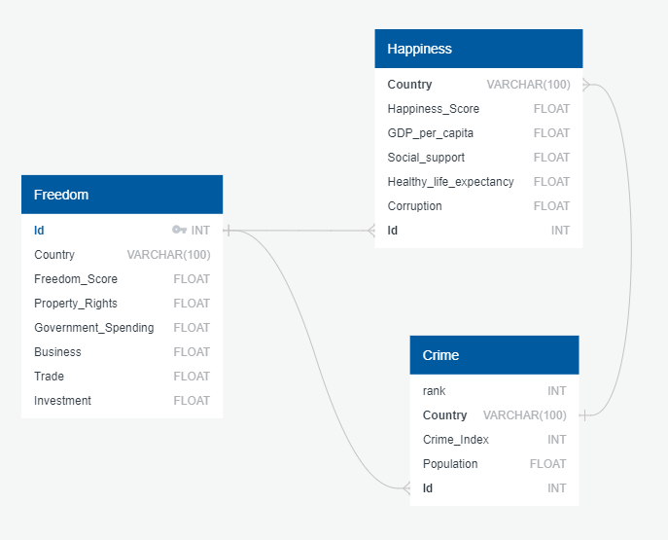
Building SQL Database

Slide 4
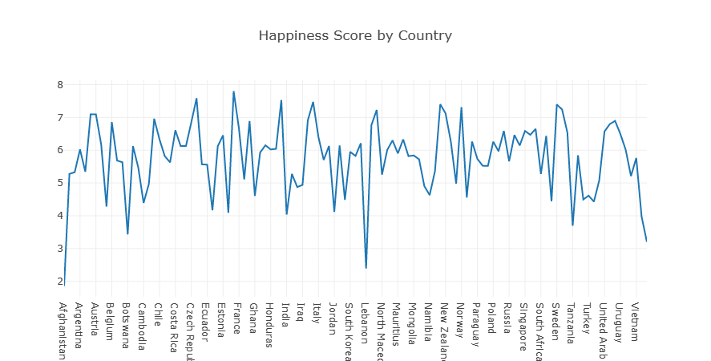
Happiness Score by Country

Slide 5
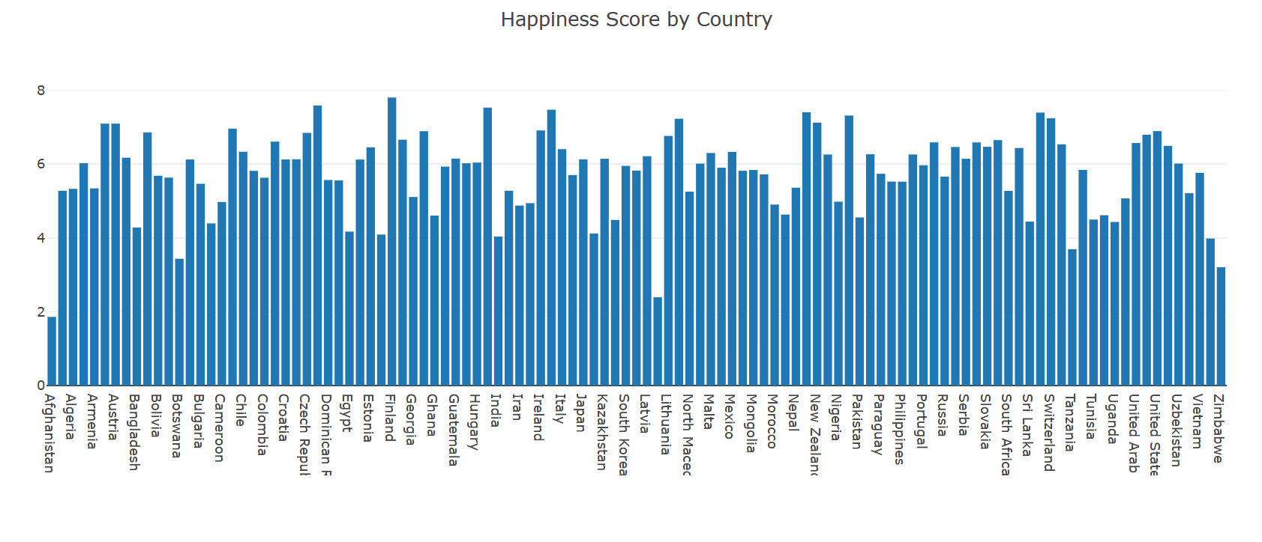
World Happiness Score

Slide 6
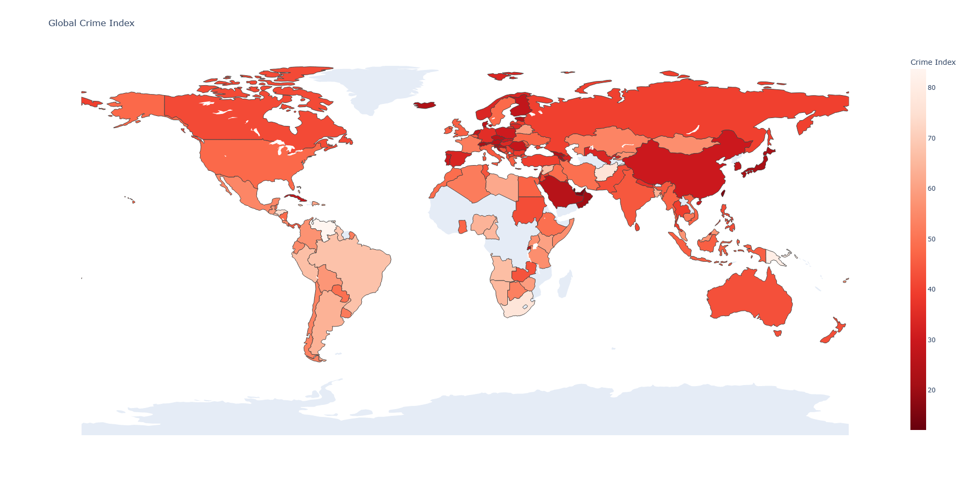
Global Crime Index

Slide 7
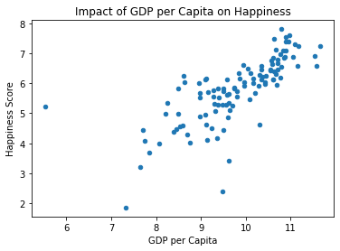
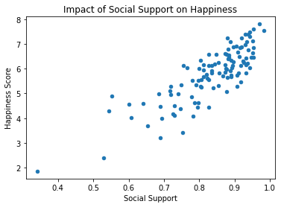
Scatter Plots

Slide 8
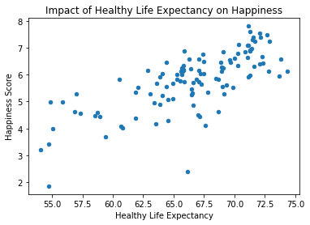
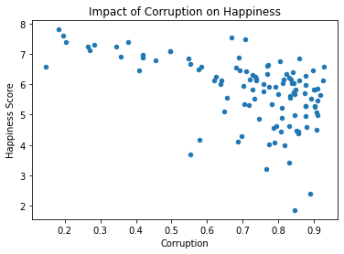
SCATTER PLOTS

Slide 9
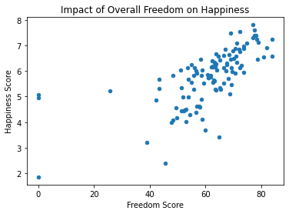
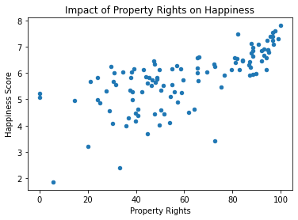
SCATTER PLOTS

Slide 10
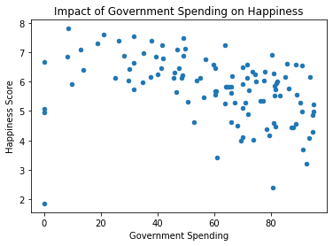
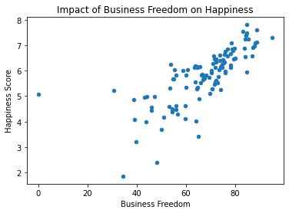
SCATTER PLOTS

Slide 11
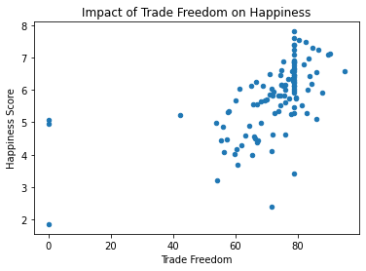
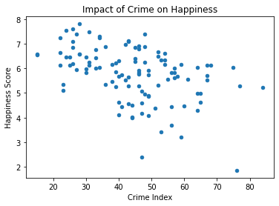
SCATTER PLOTS

Slide 12
SCATTER PLOTS

Slide 13
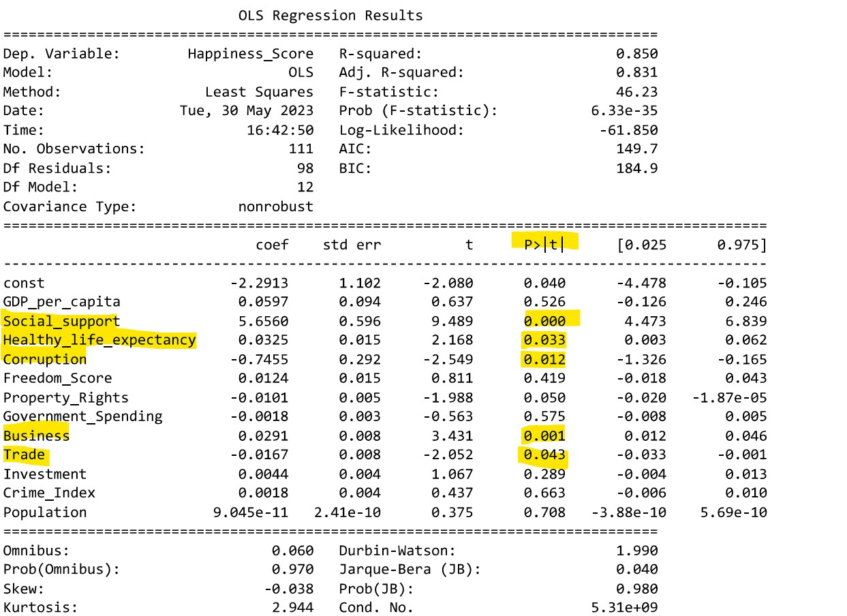
REGRESSION RESULTS
Statistical Significant Variables:
Social Support
Healthy Life Expectancy
Corruption
Business Freedom
Trade Freedom

Slide 14
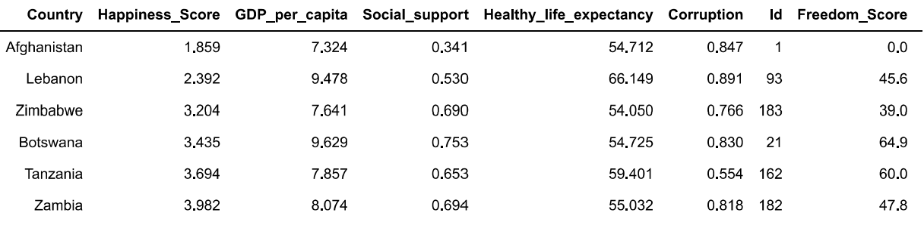
Bottom 6 Countries (Happiness): Social Support and Corruption

Slide 15
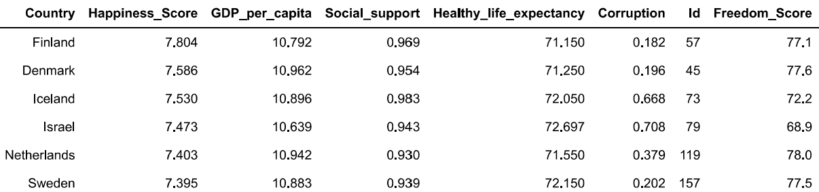
Top 6 Countries (Happiness): Social Support and Corruption

Slide 16
THANK YOU.
TEAM EXODUS

